Slide 1
CARIAD
Master Thesis: AI Usage in CI/CD/CT Pipelines for Compute Platforms in Automotives

Slide 2
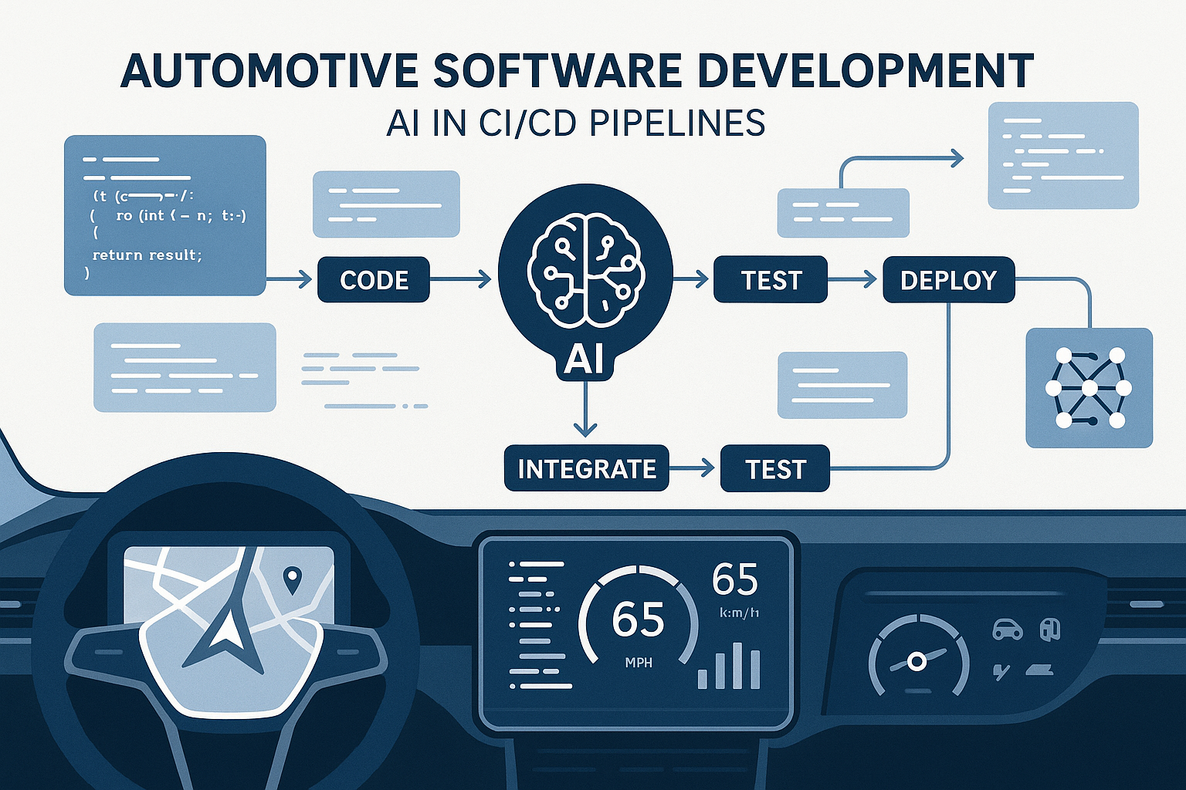
Agenda
// Introduction
// Method
// Result
/7 Status
// Next Steps

Slide 3
Introduction

Slide 4
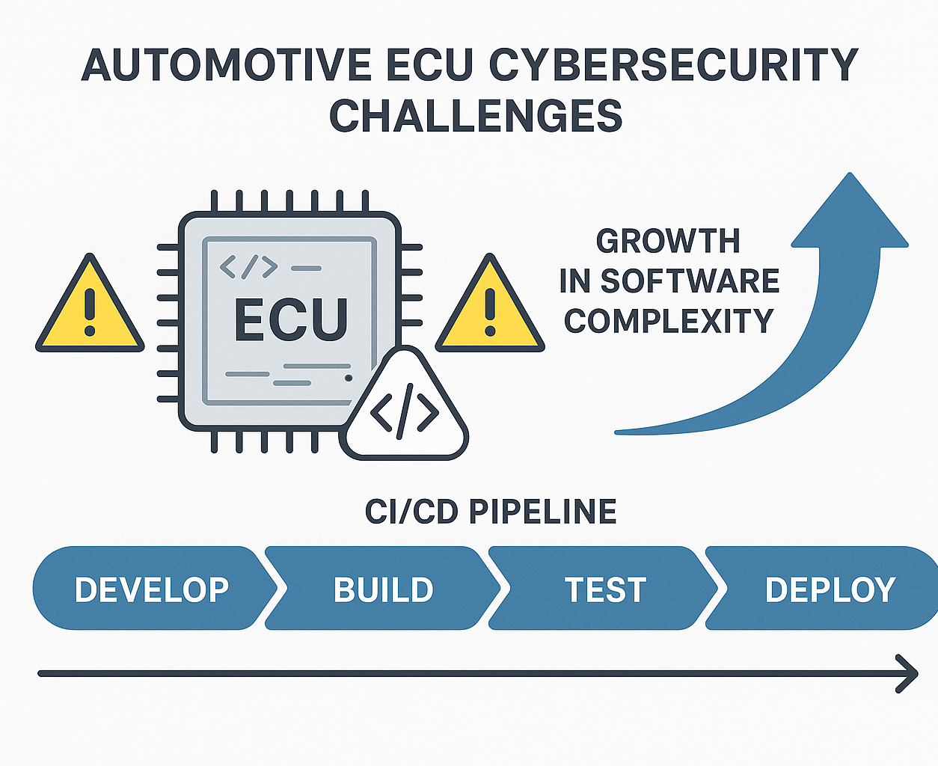
Introduction
• Rapidly growing software complexity & shorter release cycles
• Automotive ECUs are safety-critical, hence zero tolerance
• Traditional security tests cannot keep pace with CI/CD demand

Slide 5
Problem Statement
• Current white-box fuzzing & testing are manual or slow to scale
• Vulnerabilities may slip through nightly CI due to time limits
• Need an AI-guided approach integrated into CI/CD/CT to
– boost path coverage
– reduce manual fuzz test case creation
– auto-generate actionable test artifacts

Slide 6
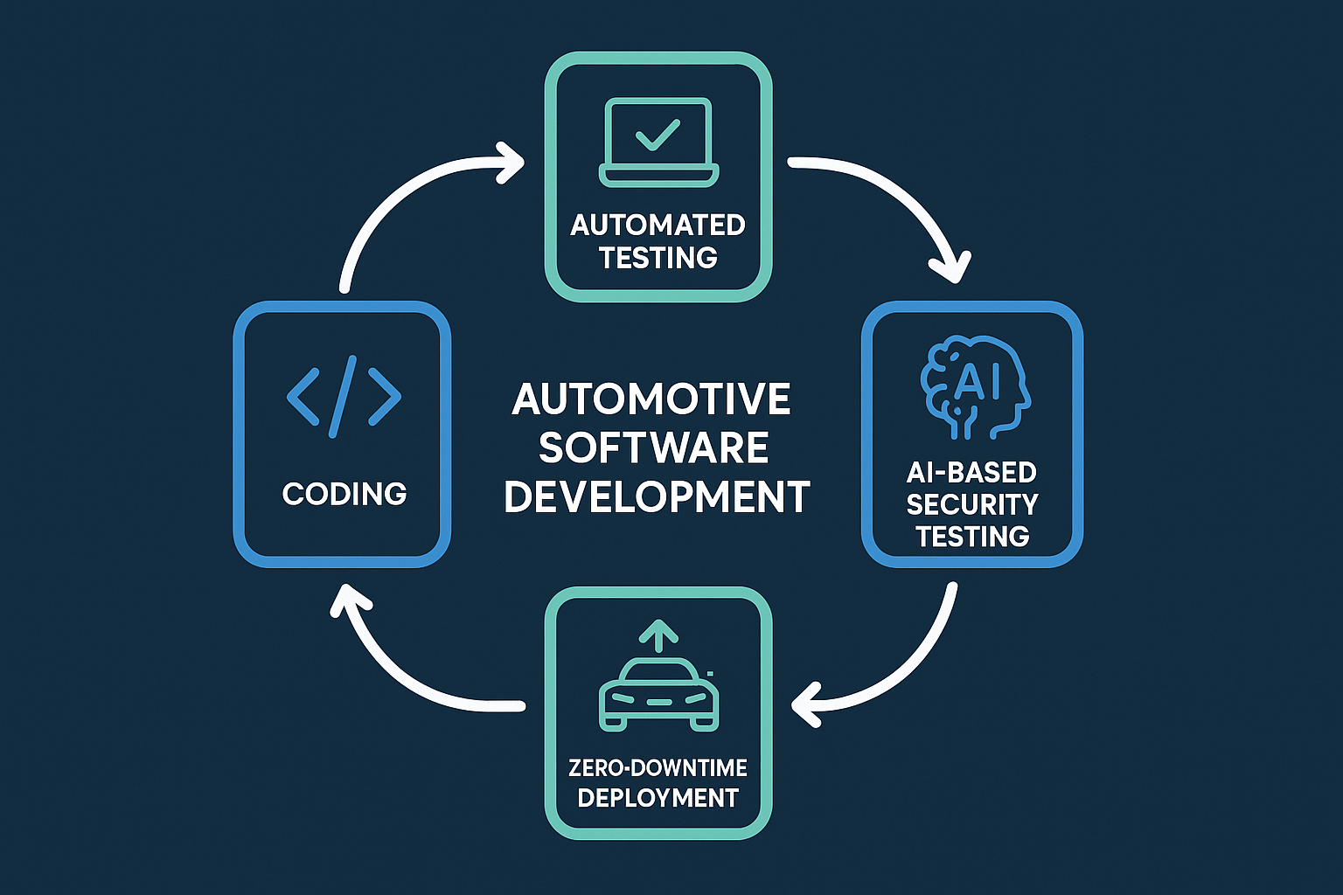
Research Objectives
Technique Design
• AI-assisted white-box fuzzing for automotive targets
Pipeline Integration
• Embed continuous fuzzing into existing CI/CD/CT
Artifact & Impact Automation
• Auto-generate test cases, reports, quality matrix
• Measure coverage, MTTV, and CI latency vs. baseline

Slide 7
Expected Outcomes
Integration into the existing CI/CD pipeline
AI-Driven Security Testing
Automation of test artifact generation
AI Generated fuzz test cases and intelligent mutation
May
Notes:
Technique Design
• AI-assisted white-box fuzzing for automotive targets
Pipeline Integration
• Embed continuous fuzzing into existing CI/CD/CT
Artifact & Impact Automation
• Auto-generate test cases, reports, quality matrix
• Measure coverage, MTTV, and CI latency vs. baseline

Slide 8
Method

Slide 9
Overview
AI-Integration
CI/CD Integration
Artifact Generation
Documentation
White box Fuzzing
Analysis and Evaluation

Slide 10
Approach
api
local
LLMs
llama.cpp
ollama
openai
lm studio
custom api
Gpt - 4o
Gpt 5

Slide 11
Local LLMs
LLMs broad classification
LLM’S models and performance
Local LLMs
Small < 15B parameters
Medium 15–25B parameters
Code specialized
Large 25-35B
parameters
Extra Large >40B parameters
General purpose

Slide 12
Models
Small (<15B parameters)
phi4:14b (14B)
llama3:latest (8B)
qwen2.5-coder:1.5b (1.54B)
qwen2.5-coder:7b (7B)
qwen2.5-coder:14b (14B)
Medium (15–25B parameters)
magistral:24b (24B)
devstral:latest (24B)
starcoder2:15b (15B)

Slide 13
Large (25-35B parameters)
gemma3:27b (27.4B)
qwen3:32b (32.8B)
deepseek-r1:32b (32.8B)
qwen2.5-coder:32b (32.8B)
deepseek-coder:33b (33B)
wizardcoder:33b (33B)
codellama:34b-instruct (34B)
yi:34b (34B)
Extra Large (> 40B parameters)
mixtral:latest (46.7B)

Slide 14
Repositories
CPP Repositories
Easy small
Easy big
Needs wrapper small
Needs wrapper big
Already Featuring CiFuzz workflow
repositories

Slide 15
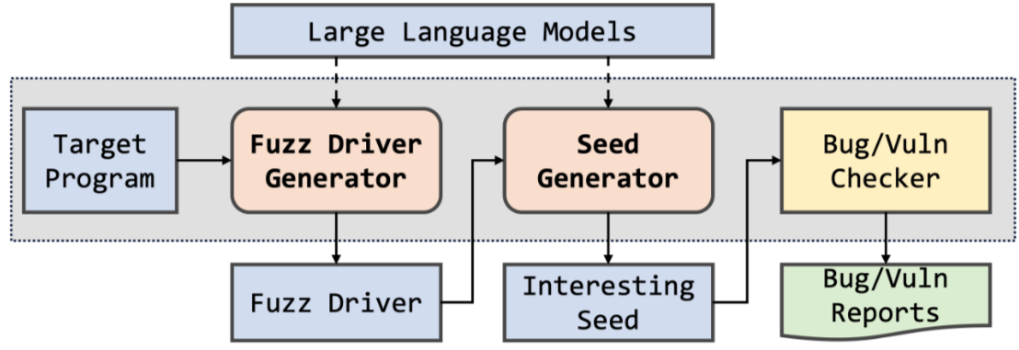
Working

Slide 16
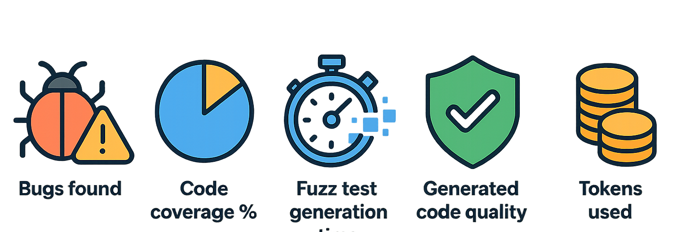
Evaluation Framework
Notes:
Number of bugs found
Code coverage percentage
Time to generate fuzz tests
Quality of generated code (measured via static analysis or manual review)
Number of tokens used

Slide 17
Finetuning local llms
Qwen 2.5 coder 32b instruct full model 60gb
LoRA (Low-Rank Adaptation)
LoRA rank (r): 16 – controls adaptation size
LoRA alpha: 32 – scaling for adaptation
Dropout: 0.1 – prevents overfitting
Target modules: q_proj, v_proj, etc. – efficient fine-tuning
Device: auto – runs on best available hardware
Dtype: float16 – faster, less memory
Efficient model loading and saving (safetensors)

Slide 18
Code examples for training
Jsonl format
{"prompt": "Generate a comprehensive parser fuzzer for structured data\n\nRequirements:\n- Maximize code coverage and edge case detection\n- Generate intelligent, targeted inputs\n- Optimize for vulnerability discovery speed\n- Include comprehensive error handling„

Slide 19
Code examples for training
Qwen 2.5 coder 32b
"completion":
"void train_timing_attack(const uint8_t* data, size_t size) {\n if (size < 20) return;\n \n const char* secret = \"supersecretpassword123\";\n std::string user_input(reinterpret_cast<const char*>(data), \n std::min(size, strlen(secret)));\n \n auto start = std::chrono::high_resolution_clock::now();\n \n // VULNERABLE: Early return creates timing difference\n bool matches = true;\n for (size_t i = 0; i < strlen(secret) && i < user_input.length(); i++) {\n if (secret[i] != user_input[i]) {\n matches = false;\n break; // Early return reveals timing information\n }\n // Simulate processing time\n }\n \n auto end = std::chrono::high_resolution_clock::now();\n auto duration = std::chrono::duration_cast<std::chrono::microseconds>(end - start);\n \n printf(\"Password check took %ld microseconds, match: %s\\n\", \n duration.count(), matches ? \"true\" : \"false\");\n}"}

Slide 20
Finetuning
32b – needs more than 60gb ram
14b – (32 – 37gb) ram
7b – 24gb ram without any background process
1.5b – 14gb ram

Slide 21
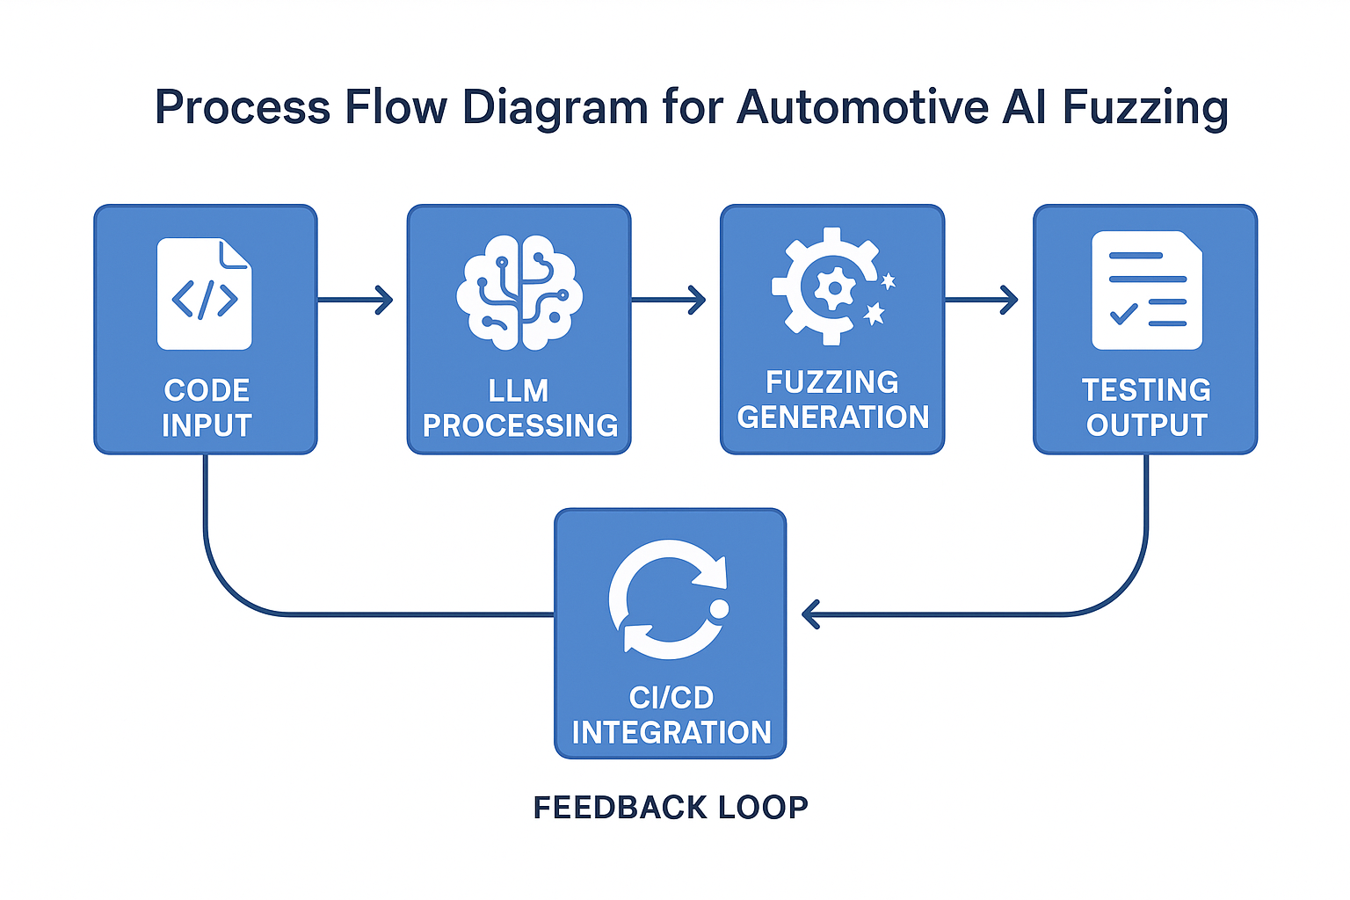
CI/CD Process flow

Slide 22
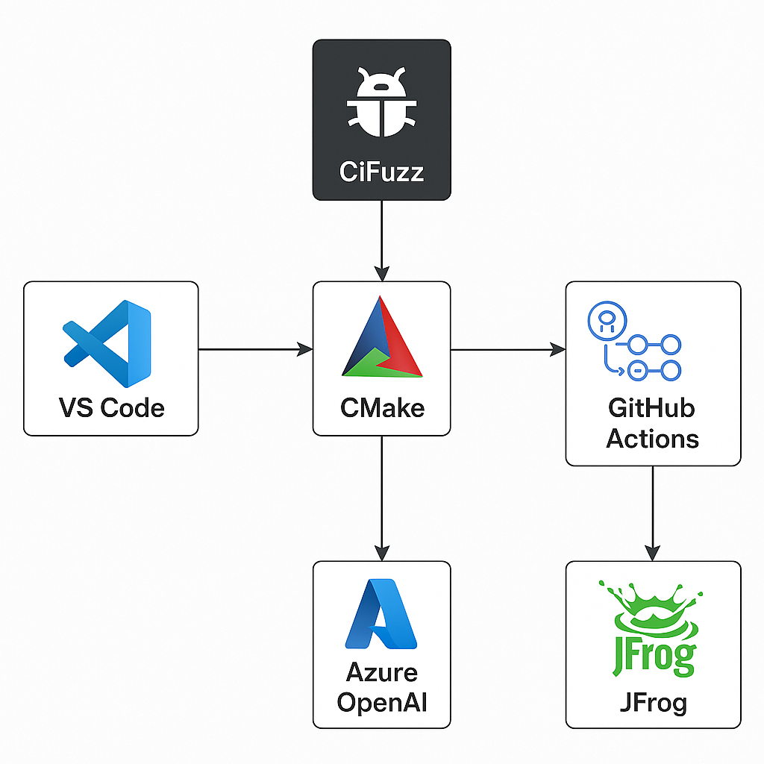
CI/CD Github Actions
buildah

Slide 23
Result

Slide 24
Models - Successful llms
Code intelligence advanced setup
Models | Code Coverage | Time Taken | No of tokens used | Unique test cases | Successfull fuzz tests
Phi 14b | 100% | 12m 8s | 59.8k | 0 | 0
Llama 3 | 100% | 3m 41s | 27.6k | 0 | 0
Qwen 1.5 7b | 89.47% | 6m 9s | 50k | 0 | 0

Slide 25
Models - Successful llms
Yaml cpp (35 files, 1061 candidates)
Models | Code Coverage | Time Taken | No of tokens used | Unique test cases | Successfull fuzz tests
Qwen 2.5 coder 32b | 43.08% | 32m 57s | 45.1k | 2.04k | 2
Gemma 3 27b | 45.06% | 33m 33s | 40.2k | 2.05k | 2
Phi 14b | 34.26% | 36m 36s | 71.5k | 2.22k | 1

Slide 26
Models - Unsuccessful llms
Yaml cpp (35 files, 1061 candidates)
Models | Code Coverage | Time Taken | No of tokens used | Unique test cases | Successfull fuzz tests
Codellama 32b | 0.00% | 50m 43s | 74k | 0 | 0
Deepseek r1 | 0.00% | 1h 36m 53s | 54.9k | 0 | 0
Deepseek code | 0.00% | 1h 37m 39s | 48.8k | 0 | 0
devstral | 0.00% | 38m 57s | 82.6k | 0 | 0
Llama 3 7b | 0.00% | 27m 40s | 268k | 0 | 0
Starcoder 2 15 | 0.00% | 19m 55s | 114k | 0 | 0
Wizardcoder | 0.00% | 32m 15s | 32.5k | 0 | 0
Yi 34b | 0.00% | 2h 39m 53s | 74.9k | 0 | 0
Magistral 24b | 0.00% | - | - | 0 | 0
Mixtral | 0.00% | - | - | 0 | 0

Slide 27
Models - UnSuccessful llms
fmt
Models | Code Coverage | Time Taken | No of tokens used | Unique test cases | Successfull fuzz tests
Qwen 2.5 coder 32b | 0.00% | 43m 20s | 59.8k | 0 | 0
Gemma 3 27b | 0.00% | 41m 59s | 73.9k | 0 | 0

Slide 28
Models - Successful llms
pugixml
Models | Code Coverage | Time Taken | No of tokens used | Unique test cases | Successfull fuzz tests
Qwen 2.5 coder 32b | 34.77% | 37m 24s | 43.1k | 2.5k | 1
Gemma 3 27b | 0.00% | 1h 12m 8s | 122k | 0 | 0

Slide 29
Models - Successful llms
Qwen 2.5 coder 32b
Repositories | Code Coverage | Time Taken | No of tokens used | Unique test cases | Successfull fuzz tests
jsoncons | 45.64% | 37m 24s | 43.1k | 2.5k | 1
glm | 0.00% | 42m 55s | 56.8k | 0 | 0
spdlog | 0.00% | 49m 33s | 62.9k | 0 | 0

Slide 30
Finetuning
NAME 1 SIZE
qwen2.5-coder:1.5b 986 MB
qwen-fuzzer-1.5-709-examples:latest 3.1 GB
qwen-fuzzer-1.5-172-examples:latest 3.1 GB

Slide 31
Finetuning - Successful llms
Yaml cpp (35 files, 1061 candidates)
Models | Code Coverage | Time Taken | No of tokens used | Unique test cases | Successfull fuzz tests
Qwen 2.5 coder 1.5b | same | 15 m | 112k
172 examples | same | 12 m | 65k
709 examples | same | 10 m | 50k

Slide 32
Costs

Slide 33
Literature review
Key Focus Areas:
AI techniques in software testing
LLM-based fuzzing approaches
CI/CD pipeline integration
Automotive security applications

Slide 34
From Traditional AI to LLMs - The Technical Journey
Key Milestones:
NeuFuzz (2019): First neural network-guided fuzzing - 35% improvement
Deep RL Fuzzing (2018): 2.3× more crashesthan AFL, 21 CVEs
TitanFuzz (2022): Watershed moment - First LLM-based fuzzer
Fuzz4All (2023):Universal multi-language fuzzing - 98 bugs found
Performance Evolution:
2018-2020: Traditional ML approaches dominated (60%)
2022-2025: LLM revolution with 50.84% coverage improvements

Slide 35
The TitanFuzz Revolution & Beyond
TitanFuzz Impact (2022):
Zero-shot capability without explicit constraints
30.38% higher coverage on TensorFlow
50.84% higher coverage on PyTorch
65 bugs discovered, 44 previously unknown
Follow-up Advances:
HGFuzzer: 24.8× speedup over traditional approaches
CKGFuzzer: Code knowledge graphs + LLMs
G²Fuzz: <$0.2 for 24-hour fuzzing campaigns

Slide 36
Automotive Domain Applications
Safety-Critical Breakthroughs:
SAFLITE: Autonomous systems fuzzing - 234.5% improvement
CAN Bus AI Fuzzing: Real-time automotive network security
ECG Embedded OS: 32 new vulnerabilities in embedded systems
KernelGPT: 24 unknown bugs, 11 CVE assignments
Automotive Applications:
Neural network validation for autonomous driving
ECU firmware testing with real-time constraints
Multi-ECU system integration testing

Slide 37
Research Gaps & Critical Findings
Identified Gaps:
Limited automotive-specific research - Most work targets general software
Real-time constraint handling - Insufficient automotive timing requirements
Multi-ECU testing - Lack of distributed architecture approaches
Standardization - No safety-critical evaluation frameworks
Quantitative Evidence:
20-90% consistent performance gains across all AI approaches
2-24× speed improvements in specialized scenarios
Hundreds of CVE discoveries with real-world impact
Cost reduction: From $1000s to <$1 per campaign

Slide 38
Key Takeaways
Major Findings:
AI-enhanced fuzzing consistently superior to traditional methods
LLM-based approaches represent paradigm shift
Industrial adoption accelerating with proven ROI
Future Research Priorities:
Automotive-specific AI fuzzing frameworks
Integration with safety standards (ISO 26262, ISO 21434)
Real-time aware fuzzing techniques

Slide 39
Costs

Slide 40
Costs
Daily Token Usage | Input Tokens | Output Tokens | Daily Cost | Monthly Cost (22 working days) | Annual Cost
Light Usage | 5,000 | 7,500 | €0.28 | €6.16 | €73.92
Moderate Usage | 15,000 | 22,500 | €0.83 | €18.26 | €219.12
Heavy Usage | 50,000 | 75,000 | €2.75 | €60.50 | €726.00
Enterprise Usage | 100,000 | 150,000 | €5.50 | €121.00 | €1,452.00

Slide 41
Costs
Literature Review
Test Scenario | Tokens Consumed | Cost per Run | Runs per Day | Daily Total
Single code file fuzzing | 2,000 in + 3,000 out | €0.11 | 10 | €1.10
Module testing | 8,000 in + 12,000 out | €0.44 | 5 | €2.20
Full application scan | 25,000 in + 35,000 out | €1.30 | 2 | €2.60
CI/CD pipeline integration | 15,000 in + 20,000 out | €0.75 | 8 | €6.00

Slide 42
Rapidjson example

Slide 43
Conclusion

Slide 44
This thesis focuses on integrating AI and LLMs into CI/CD/CT pipelines to improve the security testing of automotive software

Slide 45
Timeline
LLM Fuzzing in the ci/cd pipeline with jfrog and azure endpoints in github .
Literature Review and Familarizing with softwares
Open source llm training and cloud llm testing (OpenAi)
01
02
03
04
05
06
Local llm fuzzing and Benchmarking with Evaluation metrics
Automation of llm fuzzing locally and adaption to the production code
Writing Thesis

Slide 46
Vielen Dank für Ihre Aufmerksamkei!

Slide 47

Any Questions

